Slide 1
SNPs’ Future and Present Role in the Medicare Program
Landscape Data and Alliance Resources
SNP Alliance Spring Meeting
April 15, 2025

Slide 2
Presenting Today
Marsha Connor
Managing Director
Nils Franco
Director, Data Services
ATI Advisory
Managed Care Strategy and Operations
More than a decade of experience in managed care, government programs, and SNP and complex care delivery model operations that result in positive beneficiary health outcomes.
Former health plan CEO.
More than six years of data and consulting experience specific to Special Needs Plans and Medicare-Medicaid integration.
Leads insight generation at ATI leveraging research data assets licensed from CMS, including claims, encounters, and assessments data.

Slide 3
AGENDA
Demographic, Functional, and Morbidity Trends Elevating Special Needs Plans
Enrollment: Sources & Retention
Penetration: Enrollment Compared to the Eligible Beneficiary Population
Similarities and Differences in Special Needs Plan Types
Closing Insights & Alliance Member Resources
Q & A
PAGE 3

Slide 4
MEDICARE PROJECTED TO COVER MORE OLDER ADULTS, AT OLDER AGES, NEXT DECADE
Age of US Populations, Projected 2022-2035
For every 100
Americans age 65+ alive in 2022, there will be 131 by 2035.
Age 85+:
+72%
80M
70M
60M
Age 75-84:
+58%
The number of Americans under 65 is forecast to decline.
50M
40M
30M
20M
Age 65-74:
+9%
10M
0M
2022 2023 2024 2025 2026 2027 2028 2029
Age 65-74 Age 75-84
2030 2031 2032 2033 2034 2035
Age 85+
Source: ATI Advisory analysis of projections from the US Census Bureau, Projected Population by Five-Year Age Group and Sex, Projections for the United States: 2022-2100 (Table 3), updated October 31, 2023.
PAGE 4

Slide 5
GROWTH IN THE 65+ POPULATION COULD LEAD TO HIGHER NATIONWIDE NEED FOR LONG-TERM SERVICES AND SUPPORTS (LTSS)
Most Americans turning 65 today are projected to need LTSS, at high cost
How many Americans turning 65 today will need LTSS in their
How long will they need and use LTSS, on average?
5½ years
lifetime?
56%
How much, on average, will LTSS cost per user?
Individuals & Families
$44,800
Public Programs
$70,100
Total
$120,900
I-SNPs exclusively serve individuals with substantial LTSS needs
D-SNP integration has focused on coordination of interrelated LTSS and Medicare covered services
Source: Johnson R, Dey J. Long-Term Services and Supports for Older Americans: Risks and Financing, 2022 (Revised). U.S. Department of Health and Human Services Office of the Assistant Secretary for Planning and Evaluation; 2022.
PAGE 5

Slide 6
Total Economic Burden of Cardiovascular Disease and Diabetes in the Medicare Population (Inflation-Adjusted)
ECONOMIC BURDEN OF CARDIOVASCULAR DISEASE AND DIABETES AMONG MEDICARE BENEFICIARIES PROJECTED TO NEARLY DOUBLE IN 13 YEAR SPAN
For every $100 these conditions incurred for the Medicare population in 2022, the conditions may incur $184 in costs by 2035.
$1,164B
$751B
$632B
$424B
$414B
$209B
97% of C-SNP enrollees in 2025 are in plans that serve cardiovascular disease, heart failure, or diabetes¹
2022 2023 2024 2025 2026 2027 2028 2029 2030 2031 2032 2033 2034 2035
Cardiovascular Disease Diabetes
Main Source: Kazi DS, Elkind MSV, Deutsch A, et al. Forecasting the Economic Burden of Cardiovascular Disease and Stroke in the United States Through 2050: A Presidential Advisory From the American Heart Association. Circulation. 2024;150(4):e89-e101. Supplemental Table 3.
Cardiovascular diseases defined in the article go beyond those targeted by C-SNPs serving cardiovascular disease or heart failure.
¹ ATI Advisory SNP Alliance Quarterly Member Report on Special Needs Plan Enrollment for February 2025.
PAGE 6

Slide 7
SPECIAL NEEDS PLAN ENROLLMENT HAS MULTIPLIED IN RECENT YEARS, WITH C-SNPs ALMOST DOUBLING LAST YEAR
Enrollment in Medicare Advantage Special Needs Plans, 2016–2025
6.08M
5.86M
5.02M
Dual Eligible (D-SNP)
4.11M
Chronic Condition (C-SNP)
Institutional (I-SNP)
3.35M
1.76M
1.92M
1.11M
329K
662K
63K
388K
407K
464K
326K
88K
97K
107K
119K
122K
56K
2016
2017 2018 2019 2020 2021 2022 2023 2024
Source: ATI Advisory analysis of CMS’ SNP Comprehensive Reports for February 2016-2025. Enrollment includes plans in the 50 states, Washington DC, and Puerto Rico. Includes enrollment outside of plans’ service areas and enrollment in plans with fewer than 11 enrollees.
2025
PAGE 7

Slide 8
IN JANUARY 2024, D-SNPs NETTED THE MOST ENROLLMENT FROM MEDICARE FFS, AND SWAPPED ENROLLEES HEAVILY WITH NON-SNP MA
D-SNP Enrollment Inflow and Outflow by Plan Type
Beneficiaries Transitioning Medicare Plan Type from December 2023 to January 2024
357K
+177K
177K
152K
+92K
+69K
10K
+10K
7K
+6K
871
+121
430
+17
9K
-1K
-750
-413
-10K -1K
-61K
-107K
-180K
Total
Medicare FFS Non-SNP MA New Medicare
Inflow to D-SNP Outflow from D-SNP
MMP I-SNP PACE
Net Change (Inflow + Outflow)
C-SNP
Source: ATI Advisory analysis of the 2023 and 2024 Medicare Master Beneficiary Summary File (MBSF), and CMS Plan Benefit Package (PBP) files for 2023 and 2024. To be included in the analysis, MA enrollees must reside in their plan's service area and in the 50 states and Washington, D.C. in January 2024.
PAGE 8

Slide 9
IN JANUARY 2024, NON-SNP MEDICARE ADVANTAGE CONTRIBUTED HEAVILY TO THE MONTH’S NET C-SNP ENROLLMENT GROWTH, FOLLOWED BY MEDICARE FFS
C-SNP Enrollment Inflow and Outflow by Plan Type
Beneficiaries Transitioning Medicare Plan Type from December 2023 to January 2024
145K
117K
+96K
+82K
18K
+12K
10K
+1K
77
801
+774
18
-6K
-9K
-79
-2
-27
-33
-15
-35K
-50K
Total
Non-SNP MA
Medicare FFS
D-SNP
I-SNP
MMP
PACE
Inflow to C-SNP Outflow from C-SNP Net Change (Inflow + Outflow)
Source: ATI Advisory analysis of the 2023 and 2024 MBSF and PBP files. To be included in the analysis, MA enrollees must reside in their plan's service area and in the 50 states and Washington, D.C. in January 2024.
PAGE 9

Slide 10
IN JANUARY 2024, MEDICARE ADVANTAGE CONTRIBUTED MOST TO NET I-SNP ENROLLMENT, AND I-SNPs LOST ENROLLMENT TO MEDICARE FFS, ON NET
I-SNP Enrollment Inflow and Outflow by Plan Type
Beneficiaries Transitioning Medicare Plan Type from December 2023 to January 2024
6K
2K
2K
+1K
+503
+169
750
193
79
+2
11
-24
-77
-12
-1
-121
-1K
-871
-1K
-3K
-5K
Total
Non-SNP MA
MMP C-SNP
Outflow from I-SNP
PACE D-SNP
Net Change (Inflow + Outflow)
Medicare FFS
Inflow to I-SNP
Source: ATI Advisory analysis of the 2023 and 2024 MBSF and PBP files. To be included in the analysis, MA enrollees must reside in their plan's service area and in the 50 states and Washington, D.C. in January 2024.
PAGE 10

Slide 11
DUAL ELIGIBLE INDIVIDUALS MADE UP A LARGE SHARE OF D-SNPs AND I-SNPs IN 2024, WHEREAS C-SNPs SERVED A PREDOMINANTLY MEDICARE-ONLY POPULATION
Dual Eligibility of Medicare Advantage Enrollees by Plan Type
January 2024
All MA
C-SNP D-SNP I-SNP
^{4%} 10%
Non-SNP
100%
90%
1%
80%
26%
70%
60%
76%
79%
91%
50%
89%
40%
70%
30%
20%
8%
8%
10%
16%
13%
4%
0%
5%
All MA Enrollees
C-SNP Enrollees
D-SNP Enrollees
I-SNP Enrollees
Non-SNP MA
Enrollees
Full Dual Partial Dual Non-Dual
Source: ATI Advisory analysis of the 2024 MBSF and PBP files. To be included in the analysis, MA enrollees must reside in their plan's service area and in the 50 states and Washington, D.C. in January 2024. “All MA” and “Non-SNP” includes Medicare Advantage and related programs, including PACE, MMPs, and cost plans;
PAGE 11

Slide 12
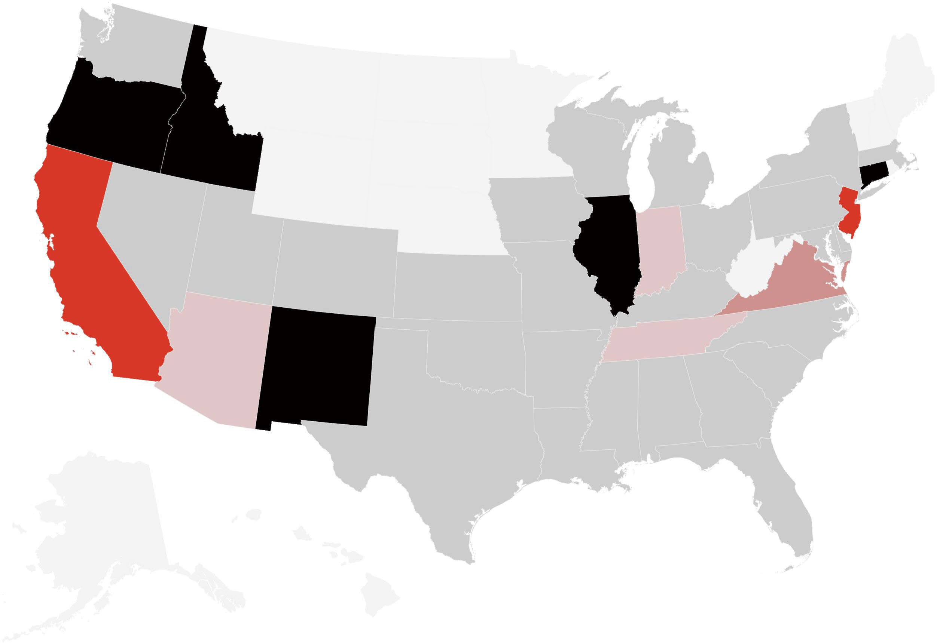
STATES VARIED WIDELY IN THE SHARE OF C-SNP ENROLLEES WHO WERE DUAL ELIGIBLE
Dual Eligible Individuals as a % of C-SNP Enrollment (Jan 2024)
WA
VT
MT
ND
ME
OR
MN
NH
ID
SD
WI
NY
MA
WY
MI
RI
CT
NV
NE
IA
PA
IL
IN
OH
NJ DE
MD DC
CA
UT
CO
WV
KS
MO
KY
VA
NC
SC
AZ
OK
TN
NM
AR
MS
AL
GA
TX
LA
FL
AK
HI
No C-SNP | C-SNP Enrollees <20% Dual | C-SNP Enrollees 20%-29% Dual | C-SNP Enrollees 30%-39% Dual | C-SNP Enrollees 40%-49% Dual | C-SNP Enrollees 50%+ Dual
13 states + D.C. | 26 states | 3 states | 1 state | 2 states | 5 states
Source: ATI Advisory analysis of the 2023 and 2024 MBSF and PBP files. To be included in the analysis, MA enrollees must reside in their plan's service area and in the 50 states and Washington, D.C. in January 2024. “All MA” and “Non-SNP” includes Medicare Advantage and related programs, including PACE, MMPs, and cost plans.
PAGE 12

Slide 13
1:2
D-SNPs ENROLLED ONE IN TWO DUAL BENEFICIARIES IN SEPTEMBER 2024
D-SNP Penetration among Dual Beneficiaries, September 2024
Partial and Full Dual Eligibility of Dual Beneficiaries by Program, September 2024
5.5M (45%)
For each dual D-SNP enrollee in September 2024, there were
about 2 dual beneficiaries in Medicare overall.
1.5M
4.1M (34%)
4.0M
.7M
34%
45%
2.6M (21%)
3.4M
1.1M
1.5M
21%
Duals in D-SNP
Duals in Non-D-SNP MA Duals in Medicare FFS
Dual Beneficiaries in D-SNP
Dual Beneficiaries in Non-D-SNP MA
Dual Beneficiaries in Medicare FFS
Full Dual Partial Dual
Among dual beneficiaries not in D-SNPs, almost two- thirds had Medicare FFS
Source: ATI Advisory analysis of the MBSF for September 2024 and includes individuals outside of plans’ service areas.
PAGE 13

Slide 14
C-SNP ENROLLMENT HAS ROOM TO GROW IN THE DIAGNOSED PATIENT POPULATION
Select C-SNP Enrollment in 2025 and Approximate
C-SNP Eligible Population (Medicare FFS Only) in 2022
16.9M
1:16
For each C-SNP enrollee in plans serving CVD, HF, or diabetes in 2025, Medicare FFS alone enrolled 16 patients diagnosed with those conditions in 2022.
3.1M
8.9M
This group represents the 97% of C-SNP enrollees in plans serving cardiovascular diseases (CVD), heart failure (HF), or diabetes
4.8M
Additional C-SNP eligible individuals are enrolled in MA (not shown).
1.1M
Enrollees in CVD/HF/Diabetes C-SNPs, 2025
CVD/HF & Diabetes
Medicare FFS CVD/HF/Diabetes Patients, 2022
CVD or HF Only Diabetes Only
ATI Advisory analysis of the 2022 Medicare Current Beneficiary Survey (MCBS) with linked Medicare FFS claims, representative of the nationwide population ever enrolled in Medicare FFS in 2022. ATI identified diagnosed C-SNP eligible cardiovascular disorders (cardiac arrhythmia, coronary artery disease, peripheral vascular disease, and chronic venous thromboembolic disorder), HF, and diabetes mellitus based on one or more diagnoses in the linked claims across settings. C-SNP enrollee count from ATI Advisory analysis of CMS’ SNP Comprehensive Reports for February 2025.
PAGE 14

Slide 15
1:37
I-SNP ENROLLMENT HAS LARGE ROOM TO GROW IN THE ELIGIBLE POPULATION – BOTH IN INSTITUTIONS AND THE COMMUNITY
I-SNP Enrollment in 2025 Compared to Approximate I-SNP Eligible Population in 2022
4.5M
For each I-SNP enrollee in 2025,
Medicare enrolled 37 people with a facility level of care in 2022.
786K
3.7M
Facility level of care definitions can vary.
Here, we define facility level of care as experiencing a long facility stay or living in the community and receiving help with 2+ Activities of Daily Living (ADLs).
122K
I-SNP Enrollees, 2025
Medicare Beneficiaries with Facility Level of Care, 2022
Facility Residents
Community with 2+ ADL Help
ATI Advisory analysis of the 2022 MCBS, representative of the nationwide population ever enrolled in Medicare (FFS or MA) in 2022. Facility residents are those with a long facility stay during the year (mean + SD LOS); community with 2+ ADL help population is non-facility residents reporting difficulty with 2 or more of 6 Activities of Daily Living (ADLs) and reporting that they receive help from another person to perform 2 or more ADLs.
I-SNP enrollee count from ATI Advisory analysis of CMS’ SNP Comprehensive Reports for February 2025.
PAGE 15

Slide 16
SNP-Eligible Populations’ Overlapping SNP Eligibility Status 2022
SUBSTANTIAL ELIGIBILITY OVERLAP FOR SPECIAL NEEDS PLANS VARIES BY TYPE BUT CAN INFORM POLICY AND CARE MANAGEMENT APPROACHES
D-SNPs and I-SNPs’ eligible populations largely overlap other SNP types, while most C-SNP eligible individuals are only eligible for C-SNPs.
Data represent the Medicare FFS population in 2022.
C-SNP eligible: diagnosed with C-SNP cardiovascular diseases, heart failure, or diabetes in FFS claims. (Note: C-SNPs can target other condition groups.)
D-SNP eligible: full or partial dual eligibility.
I-SNP eligible: facility resident or receives help with 2+ ADLs.
Medicare FFS Population
20% of C-SNP
eligible FFS beneficiaries were also
D-SNP and/or I-SNP eligible
5%
19%
38%
4%
10%
65% of D-SNP
eligible FFS beneficiaries were also
C-SNP and/or I-SNP eligible
8%
39%
86% of I-SNP
eligible FFS beneficiaries were also
C-SNP and/or D-SNP eligible
16%
80%
32%
35%
14%
C-SNP Eligibles
D-SNP Eligibles
I-SNP Eligibles
Eligible for Only One SNP Type | C-SNP & D-SNP C-SNP & I-SNP D-SNP & I-SNP | Eligible for All Three SNP Types
 | Eligible for Two SNP Types
ATI Advisory analysis of the 2022 MCBS with linked Medicare FFS claims, representative of the nationwide population ever enrolled in Medicare FFS in 2022.
PAGE 16

Slide 17
SNP TYPES SHARE IMPORTANT SIMILARITIES AND DIFFERENCES IN NONMEDICAL SUPPLEMENTAL BENEFIT OFFERINGS
Benefit Offerings (EPHRB, SSBCI, VBID) in 2025 |  | D-SNP |  |  | C-SNP |  |  | I-SNP | Non-SNP MA
 |  | % |  |  | % |  |  | % | %
Special Supplemental Benefits for the Chronically Ill (SSBCI) | Food and Produce |  |  |  |  |  |  | 31% | 15%
 |  |  | 93% |  |  | 84%
 | Meals (beyond limited basis) | 16% |  |  | 10% |  |  | 8% | 3%
 | Pest Control |  | 26% |  |  | 24% |  | 8% | 3%
 | Transportation for Non-Medical Needs | 54% |  |  | 38% |  |  | 19% | 7%
 | Indoor Air Quality Equipment and Services |  | 22% |  |  | 21% |  | 8% | 2%
 | Social Needs Benefit | 14% |  |  | 17% |  |  | 22% | 2%
 | Complementary Therapies | 2% |  |  | 3% |  |  | 8% | 1%
 | Services Supporting Self-Direction | 3% |  |  | 3% |  |  | 9% | 1%
 | Structural Home Modifications |  | 10% |  |  | 0% |  | 0% | 0%
 | General Supports for Living | 84% |  |  | 49% |  |  | 13% | 11%
Expanded Primarily-Health Related Benefits (EPHRB) | Therapeutic Massage | 5% |  |  | 7% |  |  | 8% | 4%
 | Adult Day Health Services | 2% |  |  | 3% |  |  | 8% | 1%
 | Home-Based Palliative Care | 0% |  |  | 0% |  |  | 1% | 3%
 | In-Home Support Services | 11% |  |  | 32% |  |  | 32% | 7%
 | Support for Caregivers of Enrollees |  | 4% |  |  | 15% |  | 10% | 6%
 | TOTAL Offering EPHRB or SSBCI Benefits (including through VBID authority) | 95% |  |  | 89% |  |  | 58% | 27%
 | TOTAL MA Plans | 100% |  |  | 100% |  |  | 100% | 100%
Source: ATI Advisory analysis of 2025 CMS PBP files, excludes EGHPs, PDPs, MMPs, Part B-only plans, and PACE. Note: In this analysis, we only reported the number of plans offering benefits only if they were offered under original authorities for the benefits: EPHRB authority for such benefits and SSBCI/VBID authority for SSBCI benefits. Analyses capture benefits that are filed under specific variables for the benefits above and do not capture benefits filed under “Other” categories.
A plan is the combination of a contract ID, plan ID, and segment ID. Counts shows plans offering specified benefits.
PAGE 17

Slide 18
Closing Insights
Where can Special Needs Plans play a supportive role amid demographic change?
PAGE 18

Slide 19
Reminder: SNP Alliance Technical Assistance Center and Quarterly Member Reports
Members can easily request a copy of the quarterly reports by emailing nils@atiadvisory.com
PAGE 19

Slide 20
Questions & Answers
PAGE 20

Slide 21
INFO@ATIADVISORY.COM / ATIADVISORY.COM / LINKEDIN

