Slide 1
PRESENTATION
Model of Care: Alignment Opportunities
SNP Alliance Spring Meeting
April 15, 2025

Slide 2
Learning Objectives
Gain a high-level perspective of the current status of Model of Care requirements for SNPs around key components, such as HRA, ICP
Identify areas of overlap between state and federal requirements, using examples
Articulate options for encouraging alignment between state and federal requirements
2

Slide 3
Speaker:
Molly Knowles, MPP, Senior Program Officer, Center for Healthcare Strategies (in person)
Respondents:
Matthew Behrens, Integrated Care Policy Supervisor, Virginia Dept of Medical Assistance Services (virtual)
Ryan May, CHIE, Executive Director, DSNP, United Healthcare Community & State – Virginia (in-person)
Facilitator: Deborah Paone, DrPH, MHSA, Performance Evaluation Lead & Policy Consultant, SNP Alliance (in-person)
3

Slide 4
Congress/CMS – Federal requirements for SNPs on Model of Care
Under section 1859(f)(7) of the Social Security Act, every SNP must have a Model of Care (MOC) approved by the National Committee for Quality Assurance (NCQA).
The MOC provides the basic framework under which the SNP will meet the needs of each of its enrollees. See Chapter 5 of the Medicare Managed Care Manual.
MOC Approval Process
Congressional statute gives the Secretary of HHS the authority to establish standards for the MOC approval process.
The NCQA MOC approval process scores each of the clinical and non-clinical elements of the MOC.
D-SNPs and I-SNPs are approved for one, two, or three-year periods. C-SNPs are only approved for one-year periods, so must submit annually.
Source: Model of Care (MOC) | CMS
4

Slide 5
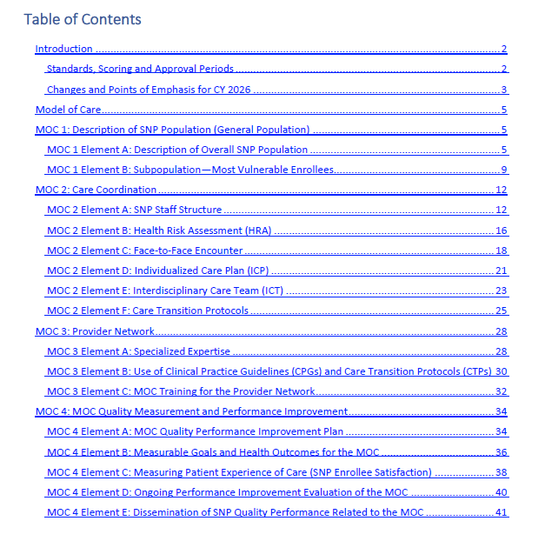
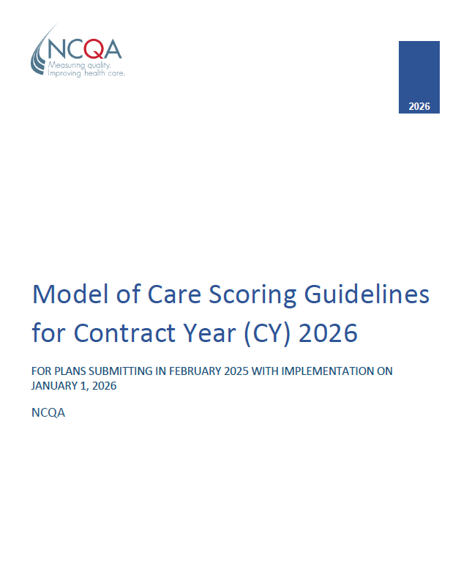
MOC Scoring Guidelines are issued by NCQA on behalf of CMS annually
Generally issued Oct. of each year for the following year’s submission
5

Slide 6
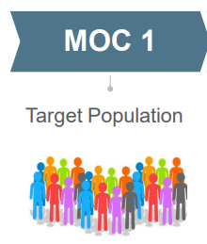
Federal Requirements - Model of Care – Domain 1
MOC 1: Description of SNP Population.
Identification and a comprehensive description of the SNP-specific population are integral to the model of care (MOC).
The model of care approach depends on a complete population description that addresses the full continuum of care of current and potential SNP enrollees, including end-of-life needs. The organization must provide information about its local target population in the service areas covered. The organization also needs to identify /define the sub-group of most the vulnerable enrollees.
6

Slide 7
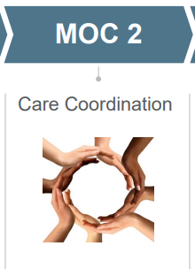
Federal Requirements - Model of Care – Domain 2
MOC 2: Care Coordination Regulations at 42 CFR § 422.101(f)(2)(ii)-(v); 42 CFR § 422.152(g)(2)(vii)-(x)
Requires SNPs to coordinate the delivery of care and measure the effectiveness of delivery of care coordination. Care coordination helps ensure that SNP enrollees’ health care needs, preferences for health services and information sharing across health care staff and facilities are met over time. Care coordination maximizes the use of effective, efficient, safe, high-quality services (including those furnished outside the SNP’s provider network) that lead to improved health care outcomes. Elements include:
Staff Structure
Health Risk Assessment
Face 2 Face Encounter
Individualized Care Plan (ICP)
Interdisciplinary Care Team (ICT)
Care Transition Protocols
7

Slide 8
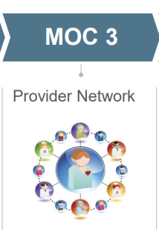
Federal Requirements - Model of Care – Domain 3
MOC 3: Provider Network
The SNP provider network is a network of health care providers who are contracted to provide health care services to SNP enrollees with specialized expertise as relevant/necessary to address the unique or specialized needs of the target population as identified in MOC 1.
SNPs must identify and fully describe the providers in their network, train/orient them to the plan’s model of care, and oversee the involvement in the ICP and ICT.
8

Slide 9
Federal Requirements - Model of Care – Domain 4
MOC 4: MOC Quality Measurement and Performance Improvement Regulations at 42 CFR § 422.152(g) require that all SNPs conduct a quality improvement program that measures the effectiveness of its Model of Care.
The goal of performance improvement and quality measurement is to improve the SNP’s ability to deliver health care services and benefits to its SNP enrollees in a high-quality manner. Incorporation of quality measurement and improvement actions can drive organization change and increase effectiveness and efficiency.
The leadership, managers and governing body of a SNP organization must have a comprehensive quality improvement program in place to measure its current level of performance and determine if organizational systems and processes must be modified, based on performance results.
9

Slide 10
Example - Focus Area: Health Risk Assessment
Factor 1: Conduct initial and annual HRA assessments
The plan must complete the HRA for each enrollee for an initial assessment. The HRA must assess the medical, functional, cognitive, psychosocial, and mental health needs of each SNP enrollee. The MOC must include detailed information on the data collected via the HRA and the methodology employed to gather this data. The plan must conduct an annual reassessment after the completion of the initial assessment
Factor 2: Use of HRA information to develop the ICP
Regulations at 42 CFR 422.101(f)(1)(i) require that SNPs address the results of the initial assessment and annual reassessment of each individual enrolled in the plan in the ICP. The results of each subsequent assessment must be incorporated into the enrollee’s ICP plan. The plan must include a description of the policies and procedures it uses to develop and update, in a timely manner, the ICP for each enrollee.
Factor 3: Disseminate HRA information to the ICT
The plan must describe its process for disseminating all HRA (i.e., initial, reassessment) information to the ICT and subsequently detail how the ICT uses this information during care coordination.
10

Slide 11
Example - Focus Area: Individualized Care Plan
An individualized care plan (ICP) is required for every person enrolled in a SNP
Factor 1: Essential components of the ICP
The plan must develop an ICP for each enrollee to deliver appropriate care.
The ICP must include but is not limited to:
The enrollee’s self-management goals and objectives.
The enrollee’s personal health care preferences.
A description of services specifically tailored to the enrollee’s needs.
Role of the enrollee’s caregiver(s).
Identification of goals (met or not met).
If the enrollee’s goals are not met, the MOC must describe the plan’s process for reassessing the current ICP and determining the appropriate alternative actions as well as providing the update(s).
11

Slide 12
Example - Focus Area: ICP, continued
Factor 2: Describe the ICP development process
The MOC must, at a minimum, describe the process for developing the ICP and detail how the results of the HRA initial assessment and annual re-assessment and are included in the ICP. The MOC must also include a description of how it determines the frequency for review and modification, as appropriate, as the enrollee's health care needs change. SNPs must provide a detailed explanation of how the stratification results are incorporated into each enrollee’s ICP. Additionally, the plan must describe how the enrollee or their caregiver/representative is involved in the ICP development process.
Factor 3: Detail personnel responsible for ICP development
The MOC must indicate and detail the personnel responsible for developing the ICP. The description of responsible staff must include roles and functions, professional requirements, and credentials necessary to perform these tasks. Plans may reference MOC 2A to provide a full description of the roles and associated credentials.
Factor 4: Specify ICP documentation and maintenance
The MOC must describe how the ICP is documented and updated with information collected from more recent HRA assessments and where the documentation is maintained. ICP documentation must be accessible to the ICT, provider network, and enrollees and/or their caregivers.*
12

Slide 13
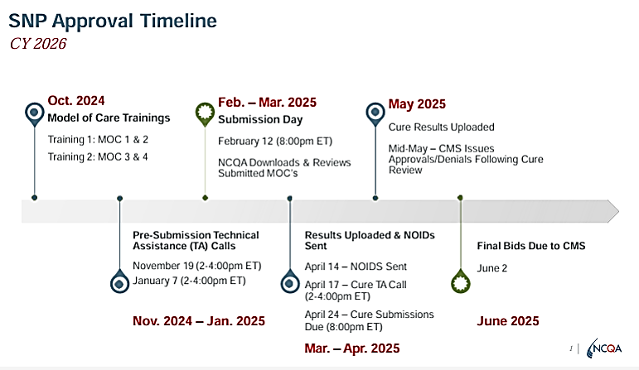
Federal Standard: Timeline for MOC review & approval
SNPs begin writing and preparing their Model of Care no later than November for submission to NCQA the following February.
Federal timeline requires review & approval in order for the plan to submit a bid to CMS by June.
Without approval, the plan cannot operate.
13

Slide 14
Off-Cycle Submission – Additional Information/Guidance from CMS:
Dual Eligible (D-SNP) and Institutional (I-SNP) SNPs with a previously approved Model of Care (MOC), must submit Off-Cycle MOC documentation when there are substantive changes to operational processes (June 1 through November 30).
Changes to the MOC are at the SNP’s discretion; however, it is the responsibility of the SNP to notify The Centers for Medicare & Medicaid Services (CMS) of any substantive changes to the MOC via electronic submission to CMS’s Health Plan Management System (HPMS).
SNPs may not implement any changes to the MOC until the National Committee for Quality Assurance /CMS approves the changes.
NCQA staff download Off-Cycle submissions on the 15th of each month. Unless there are unresolved issues requiring additional review or guidance, the results are uploaded by the 15th of the following month.
SNPs need to plan ahead if they anticipate substantive changes to the processes they’ve outlined in their approved MOC. The window to notify CMS/NCQA is only open 6 months and the review by NCQA will take at least a month or two.
https://snpmoc.ncqa.org/static/media/SNP_MOC_Off-Cycle_Submission_Guidelines.6b195db271d66241dde2.pdf
14

Slide 15
State Landscape - Model of Care - Overview
Speaker:
Molly Knowles, MPP, Senior Program Officer, Center for Healthcare Strategies
15

Slide 16
16

Slide 17
17

Slide 18
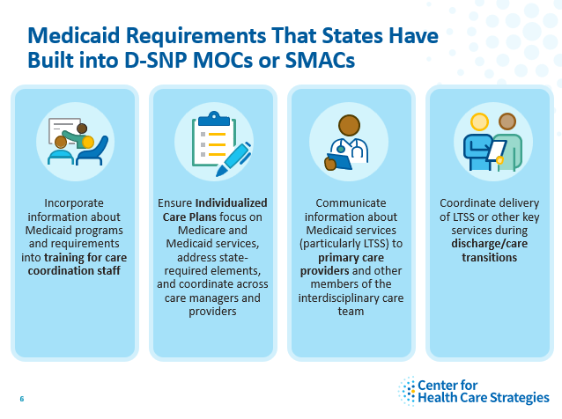
18

Slide 19
State Perspective: Virginia
State of the State
All DSNPs must have a Medicaid Managed Care (MMC) Contract and vice versa.
All DSNPs must operate with Exclusively Aligned Enrollment.
All DSNPS must integrate MOC/Care Coordination.
Must adopt the State’s MOC unless it conflicts with Federal Requirements.
Positives
Collaboration – training, problem solving, etc.
Streamlined/Simplified process for members.
Pain Points
Process – DSNP Submission to CMS and timing.
Differences in MOC Approach/Requirements.
Impact to MMC PMPM.
19

Slide 20
SNP Perspective
Current View
Awareness, Understanding, and Agreement
Requirement for HRA Questions updated annually
Incongruent Requirements
NCQA-LTSS, Medicare, State, CCM Certification, UHC Internal
Incongruent Goal Establishment across Medicare and State
1:1 Goals vs. Patient Centered Goals
SMI Diagnosis Adds complexity
Opportunity
Driven by Member Impact & Opportunities
Relationship & Member Driven Timeline
Consistency of Questions
Ryan May, CHIE, Executive Director, DSNP, United Healthcare Community & State – Virginia
20

Slide 21
Collaboration and Alignment Opportunities
21

Slide 22
Collaboration & Alignment Opportunities
22

Slide 23
Considering Alignment & Streamlining Opportunities
Align timelines for Model of Care preparation and review – prior to February submission
States can consider existing federal requirements prior to developing additional requirements – for example on Health Risk Assessment, Individualized Care Plans, Interdisciplinary Teams, Care Coordinator requirements, etc.—can the goals of the State be met within these parameters?
Consider how and when the data will be used and how the additional requirements will be monitored (NCQA can only review the document for federal standards, and CMS can only audit for whether the federal standards were met)
23

Slide 24
Resource needed: Crosswalk of Federal & State Requirements
Standard | Federal | State A | State B
Health Risk Assessment | Content; Areas for assessment; Timing; Use; Frequency of updates
Individualized Care Plan | Content; Required component; how/when created; Who needs to be involved; Frequency of updates
Interdisciplinary Care Team | ICT composition; ICT members’ roles; Communication; Coordination between ICT members
Care coordinator staffing or other requirements | Staffing and roles defined; Credentialing; Oversight of Care Coordination
Timeline for MOC approval | October to February
Oversight of MOC | CMS – with onsite audit and audit protocol (at will)
Approval Cycle | 1, 2, or 3 years
Changes to MOC | Only allowed within a 6-month window
24

Slide 25
Questions
&
Facilitated Discussion
25

Slide 26
For more information contact Deborah Paone at dpaone@snpalliance.org
26

