Slide 1
PRESENTATION: PRESENTERS:
Alternative MA Benchmark Calculations for High Need Enrollees Tom Kornfield, MPP, MAST Health Policy Solutions
Nick Gipe, ASA, MAAA, Milliman
Chris Uding, UCare
April 16, 2025
DATE:

Slide 2
Introduction
Tom Kornfield, MAST Health Policy Solutions

Slide 3

Benchmark Background

Slide 4
Benchmark Development
FFS United States Per Capita Costs (USPCCs)
Adjustments from fee for service
  IME, KAC, GME, VA-DOD
Average Geographic Adjustment (AGA) factors
Credibility factors
Quartile adjustments
Pre-ACA benchmark caps
Adjusted FFS Rate = FFS USPCC x AGA x (1 - GME factor) x (VA-DOD Adjustment Factor) x Credibility Factor - KAC dollar Amount - IME dollar Amount
Initial Benchmark Rate = (Adjusted FFS Rate) x (quartile % + bonus %) Final Benchmark Rate = minimum(Initial Benchmark Rate, Pre-ACA Rate)
Source: 2026 Advance Notice - https://www.cms.gov/files/document/2026-advance-notice.pdf

Slide 5
Benchmark Development
FFS United States Per Capita Costs (USPCCs)
Adjustments from fee for service
  IME, KAC, GME, VA-DOD
Average Geographic Adjustment (AGA) factors
Credibility factors
Quartile adjustments
Pre-ACA benchmark caps
Adjusted FFS Rate = FFS USPCC x AGA x (1 - GME factor) x (VA-DOD Adjustment Factor) x Credibility Factor - KAC dollar Amount - IME dollar Amount
Initial Benchmark Rate = (Adjusted FFS Rate) x (quartile % + bonus %) Final Benchmark Rate = minimum(Initial Benchmark Rate, Pre-ACA Rate)
Source: 2026 Advance Notice - https://www.cms.gov/files/document/2026-advance-notice.pdf

Slide 6
FFS United States Per Capita Costs (USPCCs)
Historical Benefit Expenditures
  National Claims History (NCH) file
  Part A and Part B claims transactions
Projected Benefit Expenditures
  Separately by type of service
  Base year data trended to payment year
    2026 rate base year = 2023
  Trends
    Unit cost - fee schedule updates, other indices. Assumptions provided by the Office of Management and Budget (OMB).
    Utilization and intensity - generally based on historical trends
    Population mix
    Coverage changes (regulatory)
Source: 2026 Advance Notice - https://www.cms.gov/files/document/2026-advance-notice.pdf

Slide 7
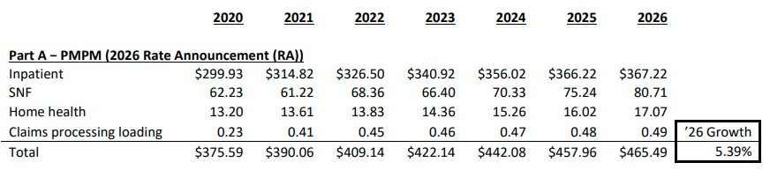
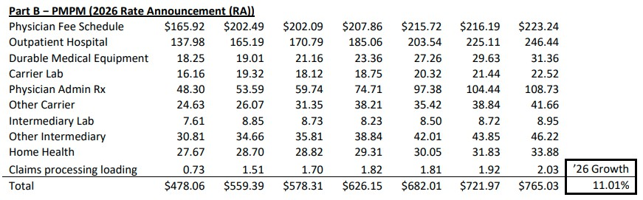
Trends
Source: https://www.cms.gov/files/document/trends-supporting-2026-ratebook-growth-rates.pdf

Slide 8
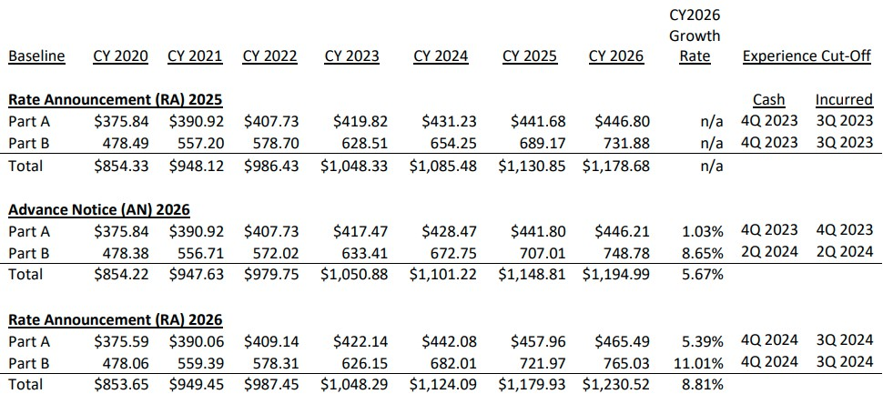
FFS Growth Rate
Source: https://www.cms.gov/files/document/trends-supporting-2026-ratebook-growth-rates.pdf

Slide 9
Benchmark Development
FFS United States Per Capita Costs (USPCCs)
Adjustments from fee for service
  IME, KAC, GME, VA-DOD
Average Geographic Adjustment (AGA) factors
Credibility factors
Quartile adjustments
Pre-ACA benchmark caps
Adjusted FFS Rate = FFS USPCC x AGA x (1 - GME factor) x (VA-DOD Adjustment Factor) x Credibility Factor - KAC dollar Amount - IME dollar Amount
Initial Benchmark Rate = (Adjusted FFS Rate) x (quartile % + bonus %) Final Benchmark Rate = minimum(Initial Benchmark Rate, Pre-ACA Rate)
Source: 2026 Advance Notice - https://www.cms.gov/files/document/2026-advance-notice.pdf

Slide 10
Average Geographic Adjustment (AGA) factors
Historical claims experience
Five-year average (2019-2023)
Reprice historical claims to current
  Wage indices, fee schedules, payment policies
  Part B drugs not repriced
Assigned to beneficiary county of residence
Various FFS adjustments
AGA factor = county specific five-year geographic index (adjusted claims) divided by county specific five-year average risk score (payment year model)
Source: 2026 Advance Notice - https://www.cms.gov/files/document/2026-advance-notice.pdf

Slide 11
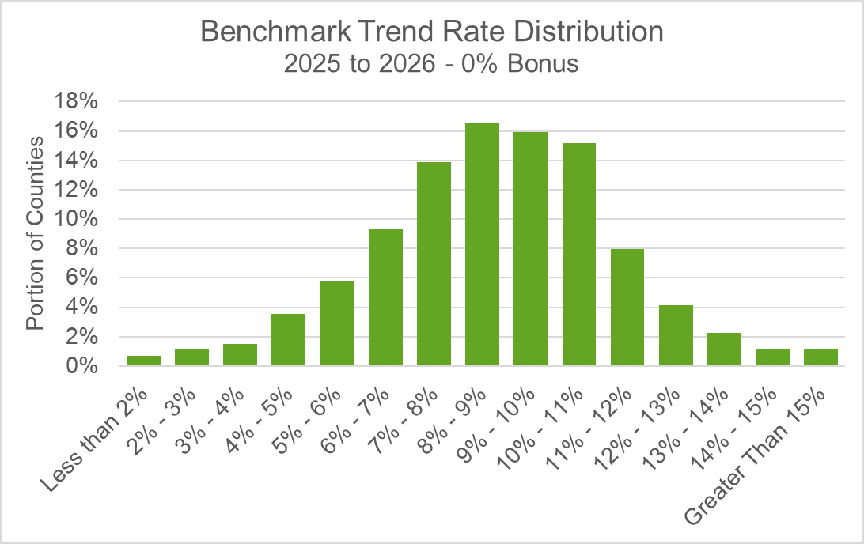
2026 Rate Announcement
8.81% Fee-for-Service Growth Rate

Slide 12
Benchmark Study

Slide 13
Background
Goal: review impact of two key components of benchmark rates –
AGA Factors and FFS Trends – for SNP-specific populations
assess whether significant differences exist between SNP-eligible populations and the total Medicare population

Slide 14

AGA Factor Review
Approach:
Illustrative Example
Summarize publicly available CMS FFS data
Generate proxy county-specific risk- normalized benchmarks for total population and SNP-specific populations
Compare relativity between total population benchmark and SNP-specific benchmark
 | Total Population Nationwide | Total Population County A | SNP-eligible Population County A
FFS costs (PMPM) | $1,000 | $1,265 | $1,625
Average risk score | 1.00 | 1.15 | 1.40
Normalized costs | $1,000 | $1,100 | $1,161
Proxy AGA factor |  | 1.10 | 1.16
SNP AGA relativity |  |  | +5.5%

Slide 15
Results – AGA Factor Review
Distribution of AGA relativities around 1.0
D-SNP Cohort (All Duals) C-SNP Group 4 (Diabetes, CHF, Cardiovascular)
14%
12%
10%
8%
6%
4%
2%
0%
Dual-eligible AGA relativity
20%
15%
10%
5%
0%
C-SNP-eligible AGA relativity
Proportion of counties
Proportion of counties
-50%
-45%
-40%
-35%
-30%
-25%
-20%
-15%
-10%
-5%
0%
+5%
+10%
+15%
+20%
+25%
+30%
+35%
+40%
+45%
+50%
-50%
-45%
-40%
-35%
-30%
-25%
-20%
-15%
-10%
-5%
0%
+5%
+10%
+15%
+20%
+25%
+30%
+35%
+40%
+45%
+50%
Source: March 2025 Milliman analysis (commissioned by SNP Alliance)
<add URL >

Slide 16
Results – AGA Factor Review
County Specific Looks
D-SNP Cohort (All Duals) C-SNP Group 4 (Diabetes, CHF, Cardiovascular)
County Name | 2019 | 2020 | 2021 | 2022
Los Angeles, CA | 2.8% | 7.1% | 6.9% | 3.8%
Cook, IL | 9.0% | 19.7% | 10.8% | 8.1%
Orange, CA | -0.7% | -4.8% | -5.3% | -4.1%
Miami-Dade, FL | 7.0% | 14.3% | 9.9% | 6.4%
Queens, NY | -1.5% | 9.9% | 2.4% | 7.5%
Philadelphia, PA | -7.0% | 1.3% | 8.0% | 3.0%
Wayne, MI | 10.3% | 19.2% | 6.5% | 0.9%
Alameda, CA | -3.2% | -2.5% | -0.7% | -4.1%
San Diego, CA | 4.8% | 16.5% | 5.0% | 13.1%
San Francisco, CA | 2.5% | -5.5% | 5.9% | -3.6%
Middlesex, MA | -1.8% | 2.4% | -2.7% | -5.7%
Sacramento, CA | -7.8% | 4.2% | 5.6% | 1.6%
Clark, NV | 13.6% | 17.6% | 16.8% | 15.5%
New York, NY | 2.2% | 20.1% | 4.2% | 13.7%
Suffolk, NY | -11.4% | 10.5% | -1.4% | 13.3%
Santa Clara, CA | -10.8% | -7.6% | -4.9% | -6.7%
Harris, TX | 19.9% | 37.8% | 23.0% | 28.5%
San Bernardino, CA | 6.5% | 8.5% | 4.3% | 1.5%
Bristol, MA | 1.8% | 0.7% | -7.5% | 3.0%
Maricopa, AZ | -13.5% | 2.9% | -4.8% | -5.5%
County Name | 2019 | 2020 | 2021 | 2022
Los Angeles, CA | 4.5% | 8.0% | 7.6% | 6.7%
Cook, IL | 4.2% | 6.0% | 5.0% | 2.4%
Harris, TX | 3.9% | 6.1% | 5.6% | 2.6%
Suffolk, NY | 3.2% | 4.4% | 1.4% | -0.7%
Kings, NY | -3.4% | -1.7% | -1.2% | 0.2%
Orange, CA | 3.0% | 2.2% | -4.5% | -0.3%
Palm Beach, FL | -0.5% | -1.9% | -1.4% | -4.6%
Nassau, NY | 0.3% | 4.7% | 1.8% | 1.2%
Wayne, MI | 3.5% | 7.0% | 6.8% | 2.9%
San Diego, CA | 3.5% | 7.5% | 5.1% | 0.2%
Queens, NY | -0.8% | 0.9% | 2.3% | 1.9%
Middlesex, MA | 1.3% | 3.9% | 1.0% | 1.1%
Clark, NV | 10.7% | 8.5% | 5.2% | 5.8%
Dallas, TX | 2.4% | 7.3% | 2.8% | 2.7%
Oakland, MI | 2.2% | 3.7% | 3.4% | 3.2%
Bexar, TX | 6.0% | 8.4% | 8.0% | 7.1%
King, WA | 2.3% | 2.9% | 7.9% | 5.6%
Baltimore, MD | -1.0% | -2.1% | 0.9% | -3.7%
Tarrant, TX | 4.7% | 5.9% | 7.2% | 0.3%
Miami-Dade, FL | 1.5% | 2.8% | 0.2% | -0.7%
Source: March 2025 Milliman analysis (commissioned by SNP Alliance)
<add URL >

Slide 17
Results – AGA Factor Review
County Specific Looks
Largest Counties by State
Consistent Patterns Emerge
In Top 20 Counties:
For two-thirds of counties, factors are either all positive or all negative
Only two had an even split of positive and
negative relativities
For most counties, the AGA factors either consistently overstate or consistently understate the costs for SNP-eligible populations.
D-SNP Cohort
County Name 2019 2020 2021
C-SNP Group 4
County Name 2019 2020 2021 2022
Jefferson, AL 7.4% 19.2% 3.3%
Anchorage, AK 4.5% 1.3% 3.7%
2022
2.9%
Jefferson, AL -5.0% -6.2% -5.4% -1.8%
-4.7%
Anchorage, AK 1.0%
-1.8% 11.3% 2.7%
1.2% -2.3% 0.1%
Maricopa, AZ Pulaski, AR
Los Angeles, CA
-13.5% 2.9% -4.8%
-2.0% 8.4% 5.8%
2.8% 7.1% 6.9%
-5.5%
Maricopa, AZ Pulaski, AR
Los Angeles, CA El Paso, CO Fairfield, CT New Castle, DE Washington DC Palm Beach, FL Fulton, GA Honolulu, HI Ada, ID
Cook, IL Marion, IN Polk, IA Sedgwick, KS
Jefferson, KY Lafayette, LA York, ME Baltimore, MD Middlesex, MA Wayne, MI Hennepin, MN Harrison, MS Saint Louis, MO Yellowstone, MT Douglas, NE Clark, NV Hillsborough, NH Ocean, NJ Bernalillo, NM Suffolk, NY Wake, NC
Cass, ND Cuyahoga, OH Oklahoma, OK Multnomah, OR Philadelphia, PA Providence, RI Horry, SC Minnehaha, SD Shelby, TN Harris, TX
Salt Lake, UT Chittenden, VT Fairfax, VA King, WA Kanawha, WV Milwaukee, WI Laramie, WY
2.7%
-11.3%
-1.8%
-2.1% -3.8% -7.4%
El Paso, CO
6.1% -0.5% -11.9%
-1.8% 0.2%
3.8%
4.5%
8.0% 7.6% 6.7%
-5.9% -8.8% -12.8%
New Haven, CT New Castle, DE Washington DC Miami-Dade, FL Fulton, GA Honolulu, HI Ada, ID
Cook, IL Marion, IN Polk, IA Sedgwick, KS
Jefferson, KY Orleans, LA Penobscot, ME Baltimore City, MD Middlesex, MA Wayne, MI Hennepin, MN Hinds, MS
Saint Louis, MO Yellowstone, MT Douglas, NE Clark, NV
Hillsborough, NH Bergen, NJ Bernalillo, NM Kings, NY Mecklenburg, NC Cass, ND Cuyahoga, OH Oklahoma, OK Multnomah, OR Philadelphia, PA Providence, RI Horry, SC Minnehaha, SD Shelby, TN Harris, TX
Salt Lake, UT Chittenden, VT Fairfax, VA King, WA Kanawha, WV Milwaukee, WI Laramie, WY
11.8%
0.5%
5.8% 7.2% -2.5%
0.9% 3.1% 0.8%
17.8% -4.6% 3.9%
14.3%
29.8%
-3.5%
7.1%
1.4% 16.2%
-7.0%
0.1%
9.1%
7.0%
9.7%
9.0%
0.2%
-1.1%
5.2%
7.9% 4.7% 11.6%
-1.9% -1.4% -4.6%
-1.4% -0.9% 6.2%
3.9% 0.2% 1.3%
2.4% 12.0% -0.1%
6.0% 5.0% 2.4%
9.9%
6.4%
-0.5%
26.3%
14.8%
16.0%
-3.3%
-6.7%
23.3%
9.4%
22.5%
56.8%
16.5%
24.5%
5.2%
4.2%
9.0%
19.7%
10.8%
8.1%
4.6%
3.8% 5.8% 0.1%
-7.0% 0.9% -1.6%
-16.9% | 9.3% | -17.9% | -0.9%
-2.2%
-12.8%
20.0%
-6.7%
-5.0%
2.2%
-1.7% -1.8% -5.4%
3.7% 3.3% 1.7%
4.2%
13.4%
6.2%
-9.6%
-4.3%
9.1%
0.8%
-5.5%
-6.3%
6.9%
8.5%
-5.8% | 5.3% | 12.1% | 4.0%
7.5% | 3.2% | -2.2% | 0.5%
-3.9%
0.7%
-1.8%
2.4%
-2.7%
-5.7%
-1.0%
-2.1%
0.9%
-3.7%
10.3%
19.2%
6.5%
0.9%
1.3%
3.9%
1.0%
1.1%
-2.8%
9.1%
-5.3%
-5.6%
3.5%
7.0%
6.8%
2.9%
17.1%
4.9%
3.3%
0.9%
-2.0% | 7.8% | 5.4% | 16.0%
3.1%
5.5%
5.2%
2.9%
-0.1%
-1.2%
2.2%
-1.9%
-0.2%
11.0%
9.0%
-21.4%
-3.0%
-5.5%
-8.3%
4.7%
1.1%
0.7%
-6.7%
10.9%
7.2%
-4.8%
-1.6%
3.9%
13.6%
17.6%
16.8%
15.5%
10.7%
8.5%
5.2%
5.8%
0.1%
8.2%
-5.5%
-4.2%
14.6%
21.4%
-2.5%
-1.0%
-19.0% -6.5% | -3.8% 0.6% | -4.6% -18.2% | 0.0% -6.4%
2.8% | 8.6% | 4.2% 2.1%
2.2%
2.8%
3.2%
-0.3%
1.4%
-2.6%
7.8%
2.6%
1.4%
-9.0%
-3.1%
1.1%
-1.4%
4.1%
1.3%
4.4%
3.9%
5.3%
-0.7%
0.5%
17.4%
13.4%
-26.7%
9.0%
-10.3%
2.2%
-8.4%
7.1%
-4.7%
7.8%
-1.8%
8.4%
4.1%
-6.4%
10.9%
-1.4%
0.9%
1.9%
-0.5%
2.0%
3.1%
3.0%
-2.4%
-11.9%
2.8%
15.8%
11.3%
-1.1%
-2.2%
-7.0%
-2.6%
5.3%
8.0%
-11.3%
-16.7%
1.3%
3.0%
5.6%
2.0%
0.3%
0.9%
-5.5%
-1.4%
-10.4%
1.7%
13.2%
14.9%
6.1%
16.8%
-13.1%
-3.4%
-14.7%
-9.5%
0.4%
6.1%
-1.8%
-4.1%
0.6%
1.2%
-16.0%
-14.5%
9.3%
-3.0%
-0.8%
8.0%
19.9%
20.0%
-3.6%
1.4%
5.0%
-1.8%
3.2%
-5.3%
3.5%
37.8%
23.0%
28.5%
3.9%
6.1%
5.6%
2.6%
-16.6%
26.2%
6.4%
-8.2%
0.0%
1.3%
6.4%
7.0%
-16.5%
17.0%
30.6%
14.4%
13.2%
-12.5%
5.5%
-15.1%
-11.7%
-3.9%
-20.0%
-22.6%
5.6%
-1.0%
2.6%
1.8%
4.6%
-8.9%
-11.9%
2.3%
2.9%
7.9%
5.6%
3.4%
17.6%
-3.9%
-6.8%
0.0%
5.2%
-3.3%
1.6%
1.2%
2.6%
-4.1%
8.3%
0.2%
0.8%
4.0%
-1.1%
-0.7%
33.0% 9.2% -15.7% 24.4% 3.6% 7.8% 13.9%
Source: March 2025 Milliman analysis (commissioned by SNP Alliance) <add URL >

Slide 18
Trend Review
Approach
Service Category Distribution
Summarize publicly available CMS FFS data
Review differences in service category
distribution
Illustrate impacts of differences in trend for differences in service category
Dual-eligible
C-SNP-eligible
Institutional
Total
0%
Inpatient
20% 40%
Skilled nursing
60%
Outpatient
80%
Professional
100%
Source: March 2025 Milliman analysis (commissioned by SNP Alliance)
<add URL >

Slide 19
Illustrative Trend Impact
Total Medicare Population
D-SNP (All Duals) Cohort
Service Category | Base Period | Illustrative Trend | 2-Year Projection
Inpatient | $298 | 4.0% | $322
Skilled Nursing | $72 | 8.0% | $84
Outpatient | $211 | 5.0% | $232
Professional | $338 | 1.0% | $345
Total | $919 | 3.5% | $983
Service Category | Base Period | Illustrative Trend | 2-Year Projection
Inpatient | $362 | 4.0% | $392
Skilled Nursing | $141 | 8.0% | $164
Outpatient | $172 | 5.0% | $190
Professional | $293 | 1.0% | $299
Total | $967 | 3.9% | $1,044
Differences in service distribution result in material differences in combined trend

Slide 20
Health Plan Experience
Chris Uding , UCare

Slide 21
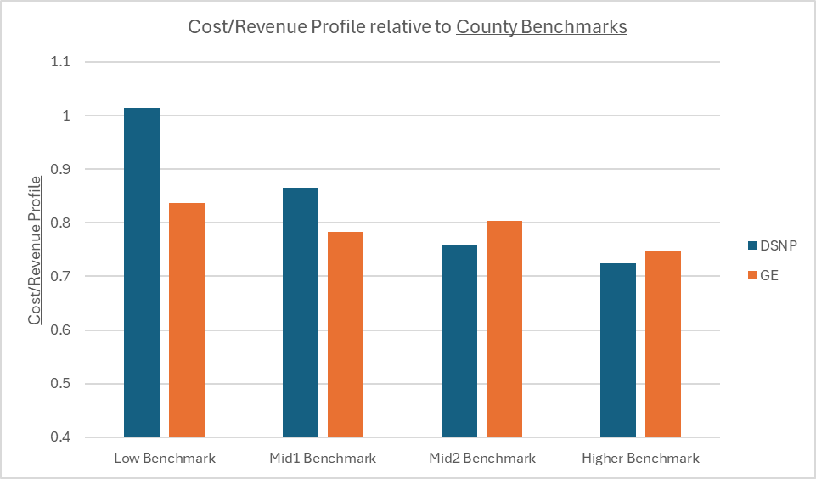
illustrative example

Slide 22
illustrative example

Slide 23

THANK YOU
Tom Kornfield - tkornfield@masthps.com Nick Gipe - nick.gipe@milliman.com Chris Uding - cuding@ucare.org

