Slide 1
PRESENTATION: Medicare Risk Adjustment Model Development PRESENTERS: Tom Kornfield, MPP, MAST Health Policy Solutions Nick Johnson, FSA, MAAA, Milliman
Matt Kazan, SCAN Health Plan DATE: April 15, 2025

Slide 2
Introduction
Tom Kornfield, MAST Health Policy Solutions

Slide 3
Recent model changes
Nick Johnson, FSA, MAAA, Milliman

Slide 4
HCC model udpate (v28)

Slide 5
Part C CMS-HCC model update (v28)
Routine data updates (CMS-HCC v27)
Model recalibration
ICD-10 diagnosis basis
HCC reclassification
HCC selection
Principle 10 Example Change in Diabetes HCC coefficients
Community Full Benefit Dual Aged Model Segment
HCC | v24¹ Coefficient | v28² Coefficient
Diabetes with Acute Complications | 0.340 | 0.186
Diabetes with Chronic Complications | 0.340 | 0.186
Diabetes without Complications | 0.107 | 0.186
Principle 10 update (CMS-HCC v28)
Constrain diabetes HCCs (36, 37, 38) to same weight
Constrain CHF HCCs (224, 225, 226)
Remove HCCs 47, 230, 265
3-year phase in (2024-2026)
Sources:
2020 CMS MA Rate Announcement: https://www.cms.gov/medicare/health-plans/medicareadvtgspecratestats/downloads/announcement2020.pdf 2024 CMS MA Rate Announcement: https://www.cms.gov/files/document/2024-announcement-pdf.pdf

Slide 6
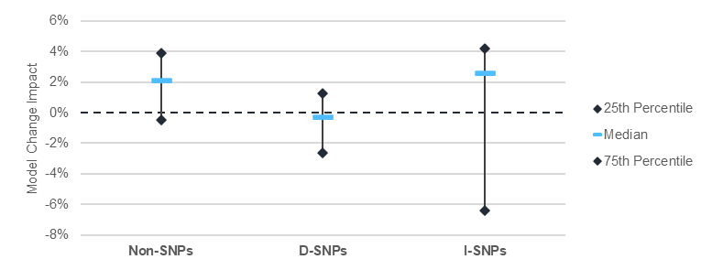
Model change impact by plan type
v28 model impact
Source: Feb 2024 Milliman analysis (commissioned by SNP Alliance) https://snpalliance.org/snp-alliance- resources/?tax%5Bwpdmcategory%5D=snp-alliance-resources-2

Slide 7
Distribution of plan-level model change impacts: D-SNP
v28 model impact
Distribution of plan-level model change impacts: I-SNP
Source: Feb 2024 Milliman analysis (commissioned by SNP Alliance) https://snpalliance.org/snp-alliance- resources/?tax%5Bwpdmcategory%5D=snp-alliance-resources-2

Slide 8
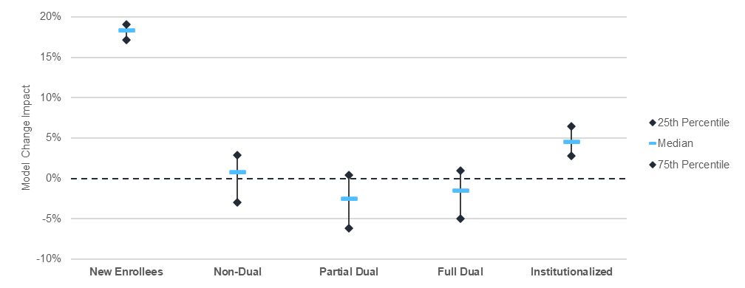
Model change impacts by member cohort¹
v28 model impact
Model change impacts by member region²
Sources:
Feb 2024 Milliman analysis (commissioned by SNP Alliance) https://snpalliance.org/snp-alliance- resources/?tax%5Bwpdmcategory%5D=snp-alliance-resources-2
Milliman analysis of v28 100% MA encounter data (commissioned by UnitedHealthcare) https://www.milliman.com/en/insight/analysis-of-2024-CMS-proposed-HCC-Model

Slide 9
RxHCC model updates

Slide 10
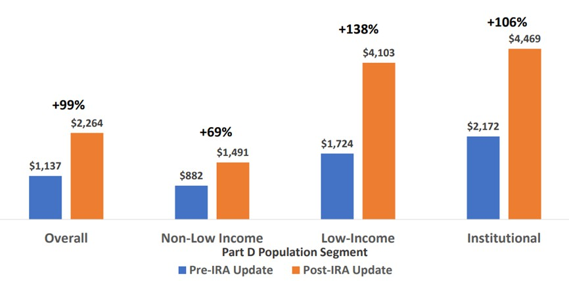
2025 RxHCC model
2021/2022 calibration
Reflects post-IRA benefit design
Expected Part D plan liability increase due to IRA¹
Initial CMS estimates of risk score changes¹
Non-low income (NLI): -15%
Low income (LI): +20%
Long term institutional (LTI): +3%
Separate normalization factors for MA-PD
and PDP
MA-PD: 1.073
PDP: 0.955
Source: (1) September 2023 CMS webinar https://www.csscoperations.com/internet/csscw3_files.nsf/F2/PtDUserGroupSlideDeck_20230914_508.pdf/$FILE/PtDUserGroupSlideDeck_20230914_508.pdf

Slide 11
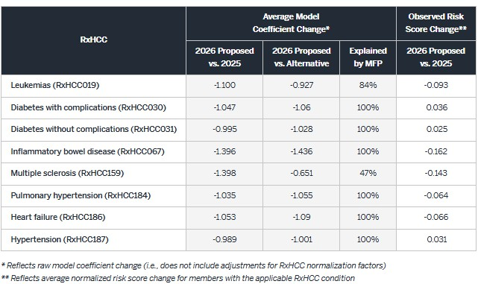
2026 RxHCC model
2022/2023 calibration
Reflects first year maximum fair price (MFP)
Impacts for key RxHCCs
Largest impacts for conditions commonly
treated by MFP drugs
Revised approach to separate MA-PD and PDP normalization factors
MA-PD: 1.194
PDP: 0.887
Source: Milliman white paper:
https://www.milliman.com/en/insight/adjusting-the-script-2026-medicare-part-d-risk-adjustment

Slide 12
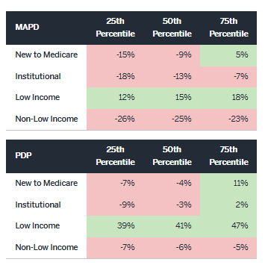
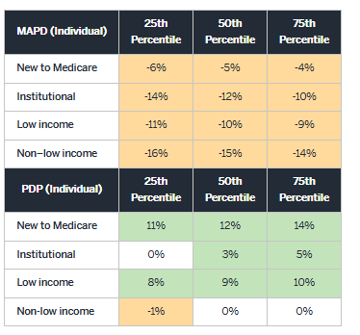
RxHCC model change impacts by plan type
2025 RxHCC vs. 2023 RxHCC¹
2026 RxHCC vs. 2025 RxHCC²
Sources:
Milliman white paper: https://www.milliman.com/en/insight/prescription-for-change-2025-medicare-part-d-risk-adjustment-model
Milliman white paper: https://www.milliman.com/en/insight/adjusting-the-script-2026-medicare-part-d-risk-adjustment

Slide 13
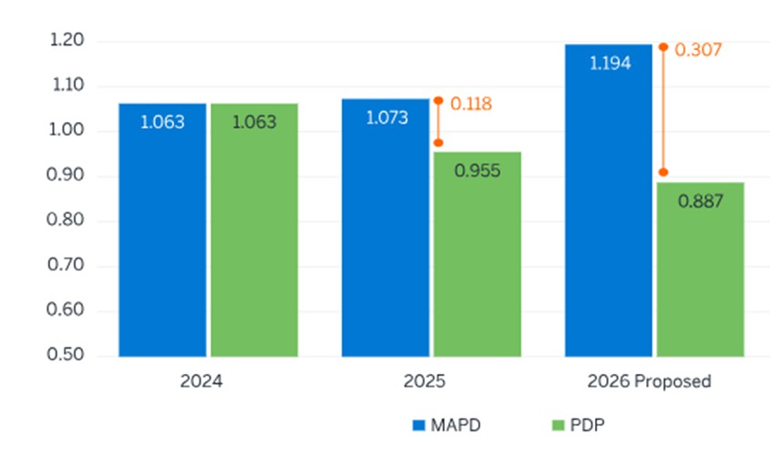
Normalization factor methodological change
Change in RxHCC normalization factors (PY2024-PY2026)
2024
2025
2026
Source: Milliman white paper: https://www.milliman.com/en/insight/adjusting-the-script-2026-medicare-part-d-risk-adjustment

Slide 14
Encounter-based risk score model

Slide 15
2026 Advance Notice
“CMS has been working on calibrating the risk adjustment model using MA encounter data (diagnosis, cost and use data submitted to CMS by MA plans), and CMS may be able to start phasing in an MA encounter data-based model as early as CY 2027. Use of an MA encounter data-based risk adjustment model is consistent with section 1853(a)(1)(C)(ii) of the Act.
Given that MA encounter data is likely a better predictor of relative costs in MA than FFS claims data from Traditional Medicare and would remove the need to make the adjustment for coding pattern differences under this provision, we believe moving to a risk adjustment model based on encounter data will be an important improvement to MA payment accuracy.”

Slide 16
Underlying data
HCC model changes
Linkage to benchmarks and AGA factors
Coding pattern adjustment and normalization factor
Implications for SNPs
Actuarial considerations

Slide 17
Caveats, limitations, and qualifications
Slides in the “Risk score model changes” section were prepared by Nick Johnson, FSA, MAAA. Nick is a Principal and Consulting Actuary with Milliman, a member of the American Academy of Actuaries, and meets the qualification standards for performing the analysis in this report. To the best of his knowledge and belief, this information is complete and accurate and has been prepared in accordance with generally recognized and accepted actuarial principles and practices. The views expressed in this presentation are strictly the views of the presenters, and not the views of Milliman, Inc. or any of its global subsidiaries. Milliman is an independent firm and provides unbiased research and analysis on behalf of many clients. Milliman does not take any specific position on matters of public policy.
The information these slides is provided for the educational use of attendees of the SNP Alliance spring forum taking place on April 14, 2025. It should not be considered complete without the oral comments that accompany the presentation. It is intended to provide the audience with an actuarial perspective on Medicare Advantage payment policies. All figures in this presentation are illustrative and for educational purposes only. It would not be appropriate to use this information for any other purpose.
This information is not intended to benefit third parties. The author makes no representations or warranties regarding the contents of this report to third parties. Similarly, third parties are instructed to place no reliance upon this information. It is the responsibility of any recipient of this report to make an independent determination as to the usefulness of the information for their organization. The information in this report does not constitute a legal opinion. It is important to seek guidance from counsel before making any decisions with respect to the determination of the impact or likelihood of any legislative or regulatory change to the Medicare Advantage program.
This analysis has relied on data from CMS as well as other publicly-available and proprietary sources. If the underlying data or information is inaccurate or incomplete, the results of this analysis may likewise be inaccurate or incomplete. We performed a limited review of the data used directly in our analysis for reasonableness and consistency and have not found material defects in the data. We have not audited or verified this data and other information. Such a review was beyond the scope of this presentation.

Slide 18
Plan perspective
Matt Kazan, SCAN Health Plan

Slide 19
THANK YOU
PRESENTERS:
Tom Kornfield tkornfield@masthps.com Nick Johnson nick.johnson@milliman.com Matt Kazan m.kazan@scanhealthplan.com

