Slide 1
Innovative Solutions to Obtain Effective Advance Directives-Opportunities for SNPs
April 16, 2025

Slide 2
Speakers
Thomas von Sternberg, M.D., Medical Director, HealthPartners Health Plan
Jessica Zan, RN, BSN, MAMFC, Senior Director, Clinical Implementations, MyDirectives
Marian Grant, DNP, ACNP-BC, ACHPN, FPCN, FAAN, RN, Clinical Advisor, NPHI, Policy Consultant, C-TAC, CAPC
Steven R. Counsell, MD, AGSF, FACP, Medical Director, Division of Aging, Indiana Family and Social Services Administration, Professor of Medicine, Indiana University School of Medicine

Slide 3
Benefits of Advance Care Planning ​
Ensure Care Preferences are known– WHAT MATTERS MOST to the member​
Increase Member and Family satisfaction with care​
Reduce Aggressive treatments at/ near end of life​
Increase Palliative Care and Hospice ​

Slide 4
Role of a SNP?​
Member education/ access to information mail, website​
Network / Contracting- Incenting the work ​
Measurement/ Reporting ​
Care coordination – Assisting Members​
Vended solutions ​

Slide 5
Advance Care Planning Ecosystems
Disrupting Inefficient Cycles of Care

Slide 6
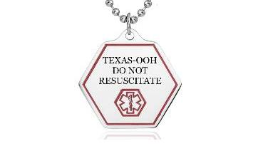
MyDirectives At-a-Glance
Industry Pioneer
Focused,
Flexible
Centered
100% on
Advance Care Planning
Gold Standard
Partners
National Reach
Flexible to
accommodate
state-level PMOs and Mental Health Advance Directives (MHADs)
Users in all
50 states
Premier Clients
Secure National Registry & Repository
Interoperability
HIT Standards Innovator

Slide 7
ACP Goals
State-wide program for out-of-hospital/portable medical orders (PMO) and advance care planning (ACP) documents
Centralized Registry & Repository for all ACP and PMO documents, easily accessible by providers, including EMS responders
Unwanted intervention avoidance at all levels of care protects patient autonomy and decrease medical resource expenditures
CMS quality improvement “What Matters Most” from 4Ms of Age-friendly Health Systems - Improved quality of care transitions
Notes:
improved quality of care transitions to reduce unnecessary hospital admissions, readmissions, and ED visits.

Slide 8
Transitions of Care: A Patient Example
Home
Skilled Nursing Facilities
Hospitals
Home Health
Long Term Care
Hospice
Notes:
Home to Hospital
Hospital to SNF
SNF to Home Health
Home Health to Hospital
Hospital to SNF
SNF to Hospital
Hospital to Hospice
Perhaps without being asked what they want
YOUR MANDATE
Identify existing transitions of care initiatives, locally, statewide and nationally to avoid duplication of work and enhance quality performance
Clarify the opportunities for improvement:
Identify key components of care transition processes
Identify barriers to discharging, transferring, or accepting patients across the continuum
Identify additional reasons for difficult transitions, or declination of patient transfers
Identify processes that have resulted in positive outcomes, i.e., best practices that can be spread
Identify priority opportunities for improvement and actionable solutions
Evaluate improvement strategies and quality data
Oversee sustainability of quality and performance improvement

Slide 9
Challenges of Paper ACP
Accessibility
Retrievability
Interoperability
Portability
Certainty
Flexibility
Notes:
Accessibility: patients obtaining correct documents to complete. Documents stored in hard to reach or unknown places
Retrievability: Documents stored in one health care system are not available to a health care system down the road
Interoperability: paper documents lack data standards that make them interoperable across EHRs
Portability: Documents may be left behind or lost as patients transition through multi-organizational, multi-acuity levels of care. What is known to one organization may no longer impact care decisions at the next.
Certainty: With paper, it can be difficult to know if an available document is the most recent,
Flexibility: Updates or changes are challenging, and susceptible to the same problems listed above.

Slide 10
End-to-End Advance Care Planning
Digital Document Creation
Digital Storage
Digital Retrieval
Actionable Insights
Individually or Facilitated
Interoperable Data Standards
EHR Integration
Data Exchanges
MyDC Licenses
Transaction Reporting
Regulatory Compliance
Quality Improvement
Notes:
Accessibility
Retrievability
Interoperability
Portability
Certainty
Flexibility
RISK STRATIFIED APPROACH to ACP completion

Slide 11
At the Center of the Ecosystem
Repository for all consumer and clinician-facilitated documentation
Upload and store digital documents, paper document uploads, and video recordings
Advance care plans, advance directives, mental health advance directives, POLSTs, MOLSTs, MOSTs, among others
Notes:
HITRUST, HITRUST

Slide 12
Helping SNP Members Have Their Voice
Increase member awareness of ACP opportunities
Investigate digital ACP
Insist on ACP as a standard of care for your members
Identify “Relationship Based Caregiving Roles”
Risk stratify interventions
Promote ACP retrieval at the point of care

Slide 13
Tiers of Solutions
Providing access to ACP creation through your patient portal
Requiring ACP facilitation as a standard of care in your contracts
Promoting fidelity to ACP documents at the point of care
Notes:
ACP is already a HEDIS measure – albeit the measure itself could be more robust.

Slide 14
ACP Ecosystem: Preventing Unwanted Interventions
Member
Universal storage
EMS retrieval
Health plan support
Digital ACP creation
Health system engagement
Government support

Slide 15
The Value of Doing the Right Thing
21%
18%
24%
31%
17%
Decreased likelihood of dying in the hospital
Increased use of hospice in last 3 days
Decreased inpatient spending
Decreased ICU utilization in last 30 days
Lower total spending
Notes:
Analyzing Medicare claims data from 2014-2018, the authors demonstrate that among decedents 12 months after an ER visit, ACP...
decreases the likelihood of dying in the hospital by 21%
increases the use of hospice care within the last 3 days of life by 18%
decreases inpatient spending by 24%
decreases ICU utilization in the last 30 days by 31%
lowers total spending by 17%
While this results in a $3,059 difference in total spending just in the last month of life, the authors project the savings per decedent who received ACP to be >$30,000 based on the earlier utilization of supportive care interventions like Palliative Care and hospice. That is, in part, because individuals who received ACP enrolled in hospice 112 days earlier than those who did not receive ACP.
The study demonstrates that the impact of ACP is especially prominent among patients with cognitive impairment, specifically Alzheimer’s and related dementias, patients with heart disease, and among dual eligibles.
With the launch of the CMS GUIDE model, incorporating high-quality ACP will be essential to delivering better care for patients with Dementia.
Historically, there have been significant disparities in access to ACP - particularly for under-represented minorities and low SES populations. These studies highlight that equitable access to ACP is key — especially given the impact ACP has for the dual-eligible population.
With the transition to the transition to CMS-HCC V28 Model, it’s harder for health plans to code their way to success - focusing on data-driven ways to improve care, quality, and effectiveness of services will be key to moving forward.
Health systems reviewing their quality metrics need to prioritize ACP given the impact it has on decreasing inpatient mortality.

Slide 16
Contact our team!
Jessica Zan, RN| VP, Clinical Implementations
jzan@mydirectives.com
405-401-3814
Thank you!

Slide 17
Promoting Advance Care Planning
Marian Grant, DNP, ACHPN, FPCN
Strategy Director, Serious Illness Messaging Grants
Serious Illness
Messaging Toolkit
Talking to the Public About Advance Care Planning, Palliative Care and Hospice

Slide 18
Objectives
Provide evidence on advance care planning
Share free online toolkit to improve advance care planning outreach
Provide tips for promoting it in long-term care and with payers
Serious Illness
Messaging Toolkit

Slide 19
Evidence highlights
Can reduce unwanted care and increase patient/family satisfaction¹
Awareness²
80% to 90% report awareness, similar proportion considered it important
But only 10% to 41% reported having named a proxy or completed written document
Why is that?
Serious Illness
Messaging Toolkit

Slide 20
2019 MASSACHUSETTS ADVANCE CARE PLANNING CONSUMER SEGMENTS³
Worried Action Takers
10%
Self-Assured Action Takers 24%
Disengaged Worriers
34%
Confident Independents
18%
Self-Reliant Skeptics
14%
Younger, diverse, most educated. Nearly half identified as having a disability.
Highest trust and regard for the health care system. ~80% have been a caregiver for an incapacitated loved one.
Oldest by far; most likely to be white and least likely to be low-income.
Confident about managing their health and navigating the health care system with fewer worries about a future serious illness.
Youngest, most diverse, lowest education and income; poorest health and health care navigation and management skills.
Seen loved one’s wishes not honored. Many worries about their health and future serious illness.
Older (mostly 45+), average education and racial composition. Fewer experiences with dying loved ones. Confident about managing their health and navigating the health care system with fewer worries about a future serious illness.
Middle-aged, lower income and education.
Lowest trust of doctors and regard for the health care system. Poorer health care self-management and navigation skills.

Slide 21
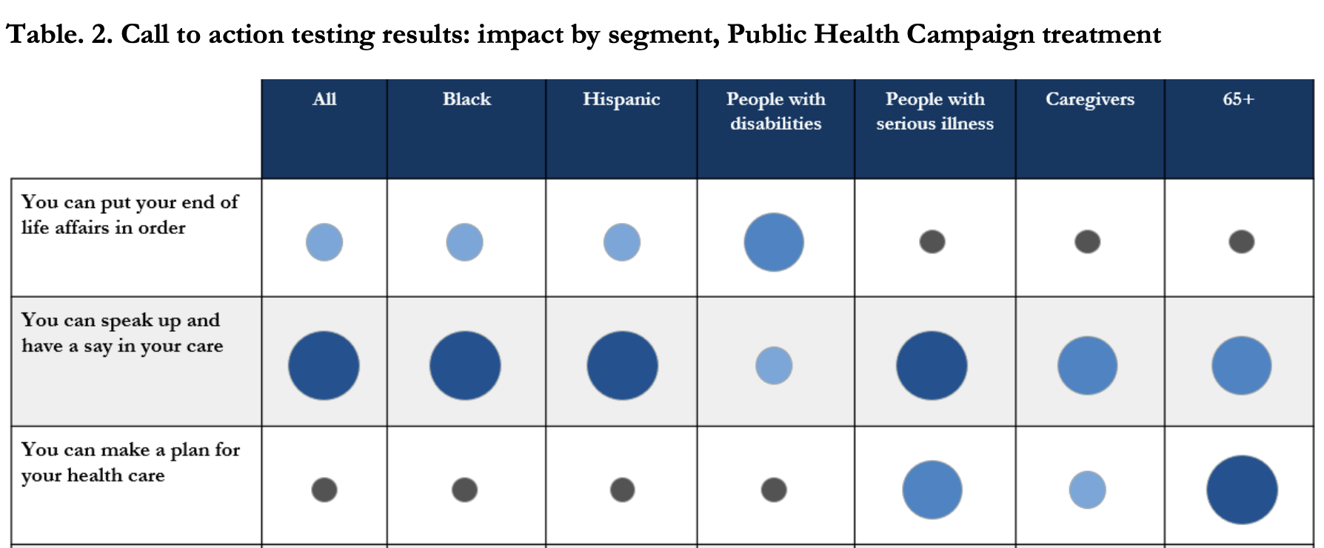

Slide 22
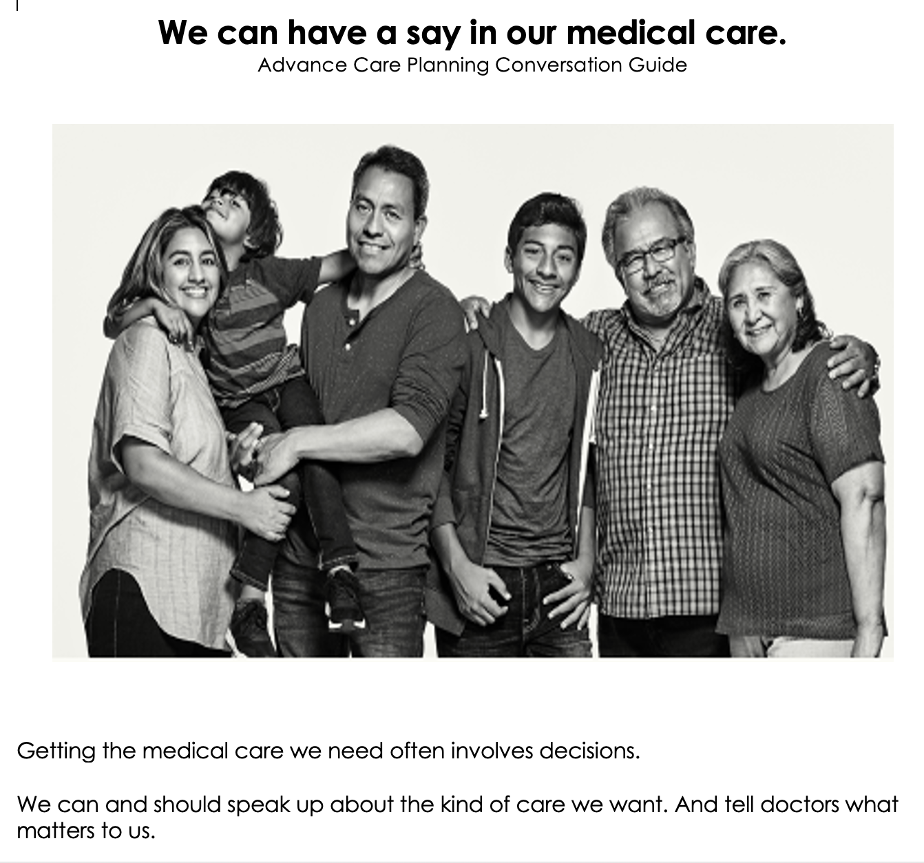
Blue Shield California

Slide 23
Messaging Principles
₁ Talk up the positives
These services and care improve peoples’ lives.
₂ Present choices for every step
At every stage of an illness, you have choices.
₃ Use stories
The stories that resonate are positive and aspirational.
₄ Invite dialogue—and not just once
The call to action is to talk with someone.
₅ Invoke a new team
Patients, families, clinicians, & community all have a role.

Slide 24
Seriousillnessmessaging.org

Slide 26
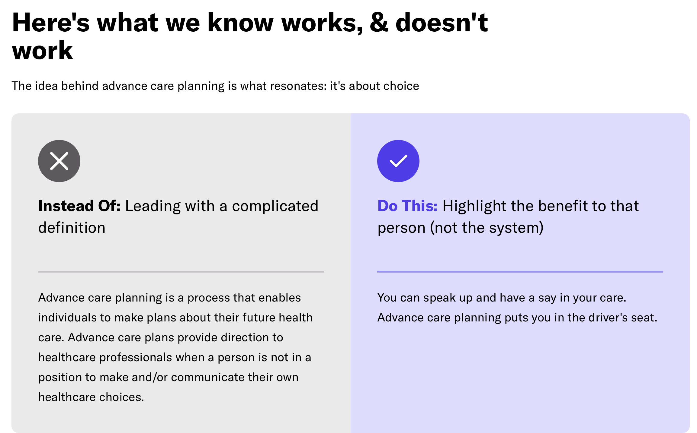

Slide 27
Steal These Messages

Slide 29
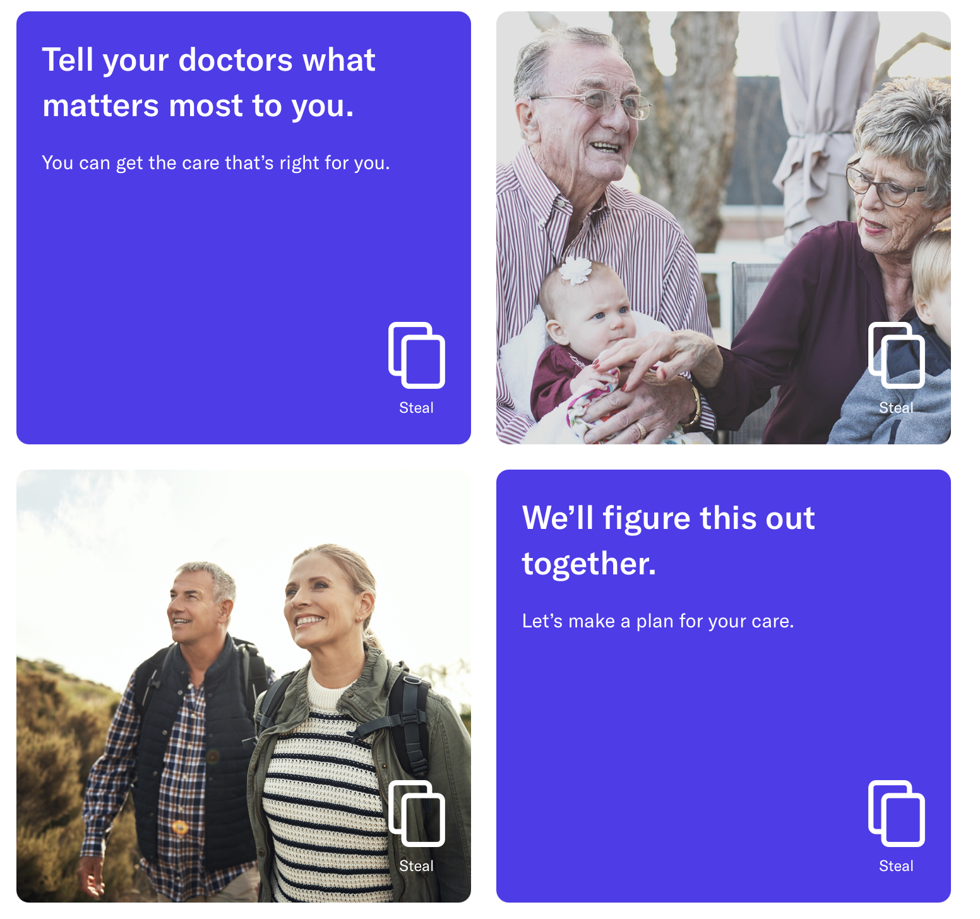

Slide 30
Outreach for facilities and payers
Advance care planning can result in people opting for less aggressive care or foregoing unwanted care, like the hospital
It facilitates patient-centered care and increases patient and surrogate satisfaction
Resources exist to help train clinicians and patients
Respecting Choices⁴
My Directives⁵
The Conversation Project⁶
Advance Care Planning HEDIS measure
Some payers include information on it as a member service

Slide 31
References
2020 Advance Care Planning Scoping Review
2021 Serious Illness Attitudes and Awareness Scoping Review
https://www.maseriouscare.org/research-resources/2019-consumer-research-messaging-support-advance-care-planning
https://respectingchoices.org
https://www.mydirectives.com
https://theconversationproject.org

Slide 32
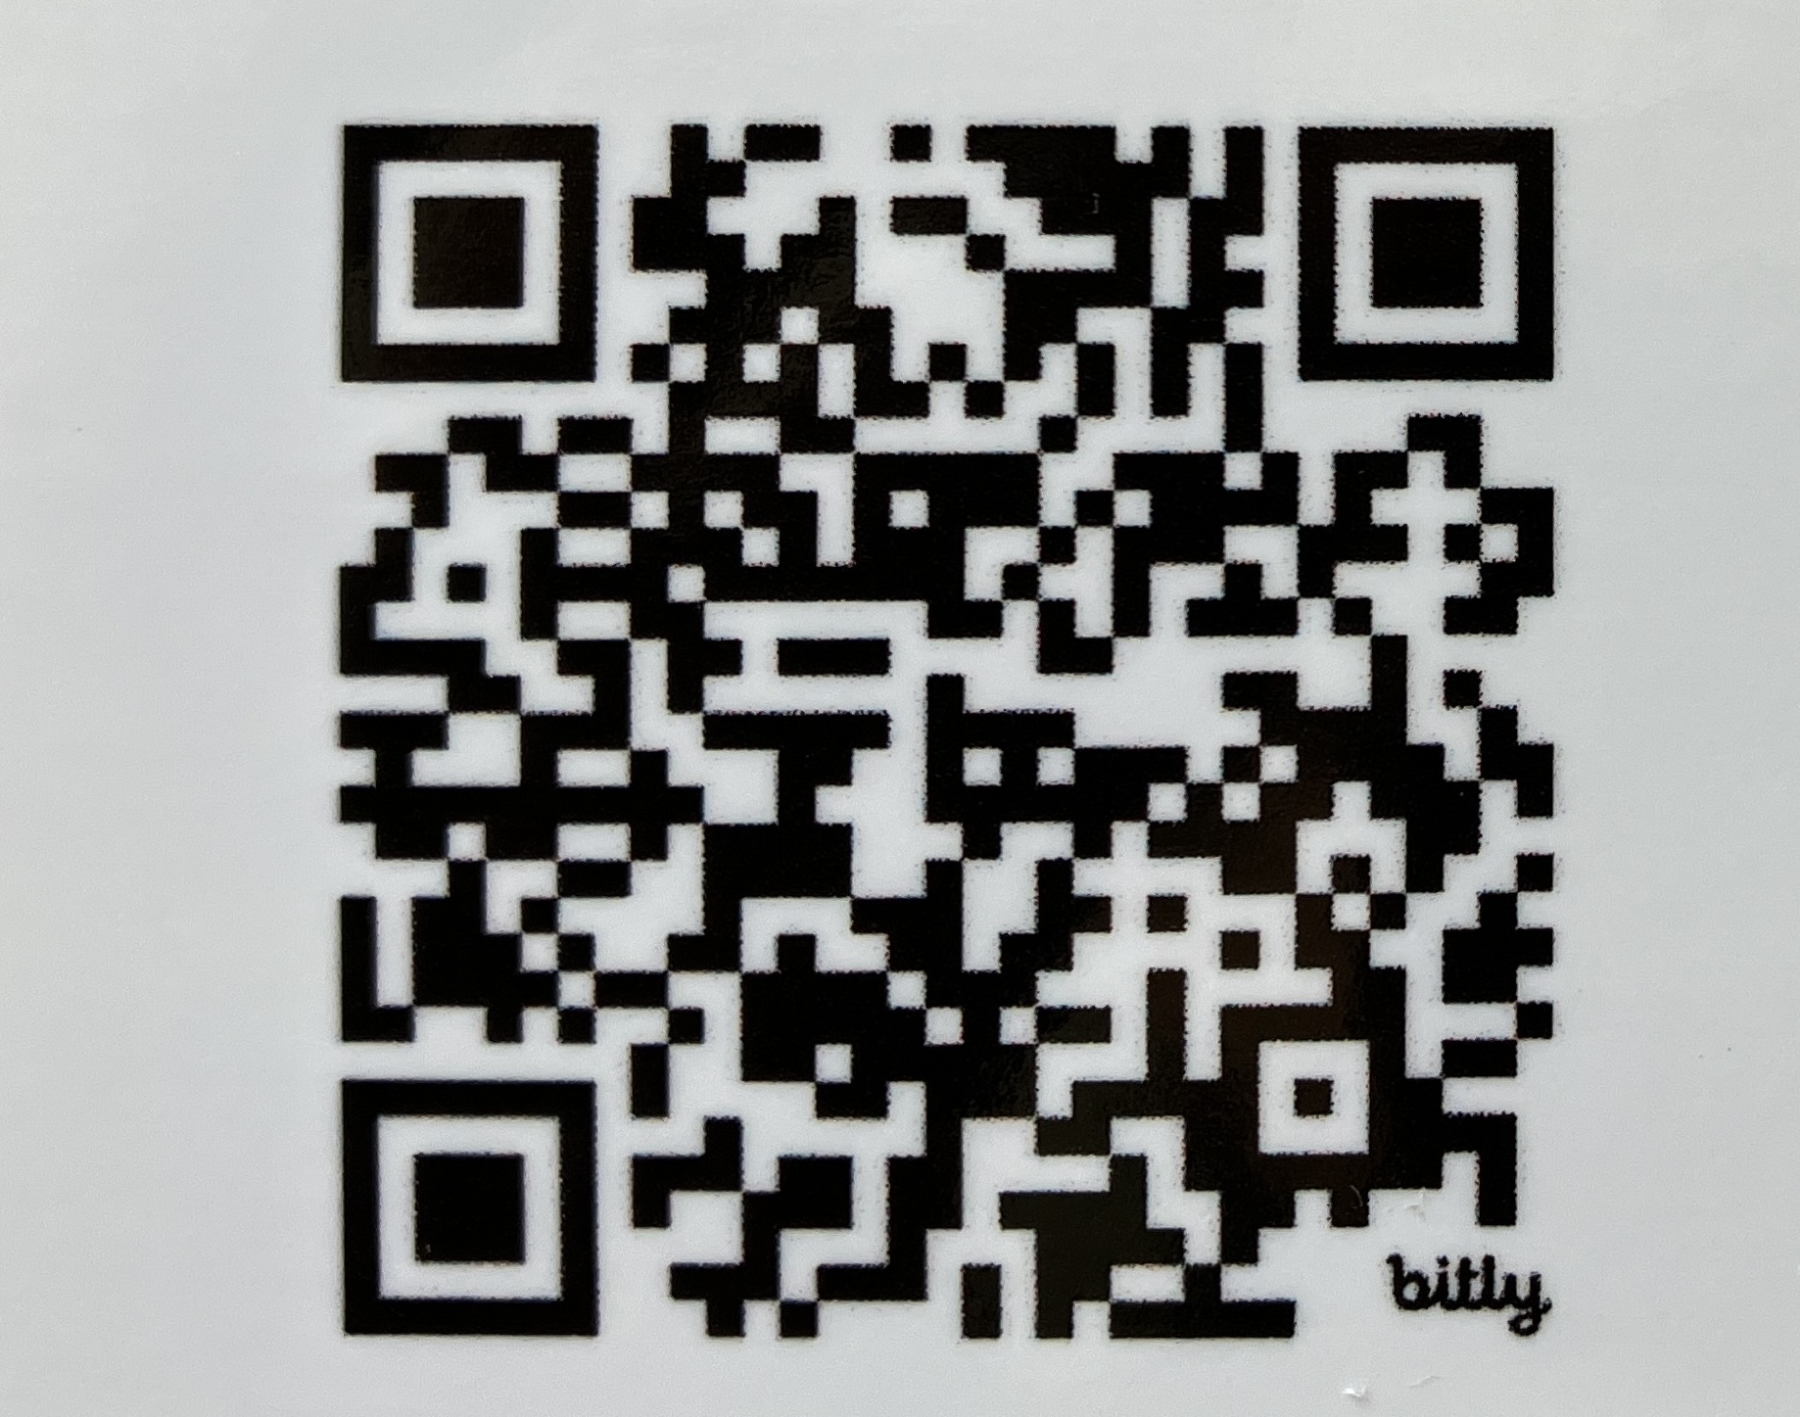
Seriousillnessmessaging.org
Marian Grant
Consultant@MarianGrant.com

